Slide 1
CREDIT EDA
CASE STUDY
Prepared by:
Vicky Kumar
(18erecs080.vicky@rietjaipur.ac.in)

Slide 2
Introduction
When assessing a loan application, the company faces two risks that influence its decision-making process:
1. Risk of missed business opportunity: If the applicant is capable of repaying the loan but the company rejects the application, it results in a loss of potential business for the company.
2. Risk of financial loss: If the applicant is unlikely to repay the loan and is at a high risk of defaulting, approving the loan may lead to financial losses for the company.
Therefore, the company must carefully evaluate each applicant's profile to mitigate these risks and make informed decisions regarding loan approvals.

Slide 3
Dataset used
The analysis is based on two datasets:
1. "application_data.csv": This dataset contains information about the current loan applications. It includes various attributes such as applicant's demographics, financial details, and loan-related information.
2. "previous_application.csv": This dataset contains information about the previous loan applications made by the same applicants. It provides insights into the applicant's past borrowing history, including details of previous loans, repayment behavior, and other related information.
By analyzing these datasets together, we can gain a comprehensive understanding of the applicants' profiles and their historical loan behavior, which helps in making informed decisions regarding loan approvals and assessing the associated risks.

Slide 4
Data cleaning
Percentage of Missing Values: The percentage of missing values in each column was calculated to assess the extent of missing data. This information helped in determining which columns had a high percentage of missing values.

Slide 5
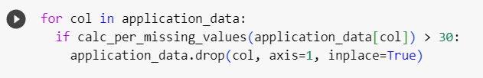
Dropping Columns
Deletion of Columns: Columns with a high percentage of missing values, typically above a certain threshold (such as 30%), were identified and deemed unnecessary for the analysis. These columns were then dropped from the dataset.
These steps ensured that the dataset used for analysis was cleaned and contained only relevant columns with a minimal amount of missing values.

Slide 6
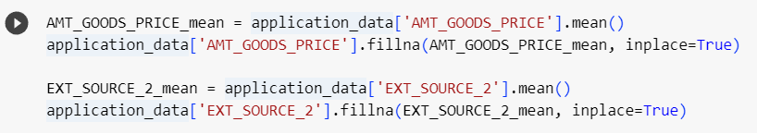
Imputing Missing Values with Mean
As AMT_GOODS_PRICE and EXT_SOURCE_2, has very low missing values and we can fill those columns with mean values.

Slide 7
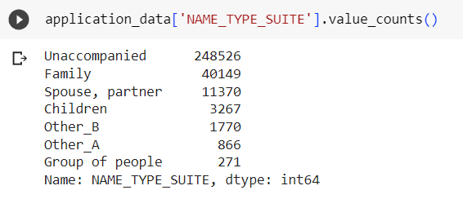
Imputing Missing Values with Mode
As part of the data cleaning process, the mode values were imputed to the NAME_TYPE_SUITE column.

Slide 8
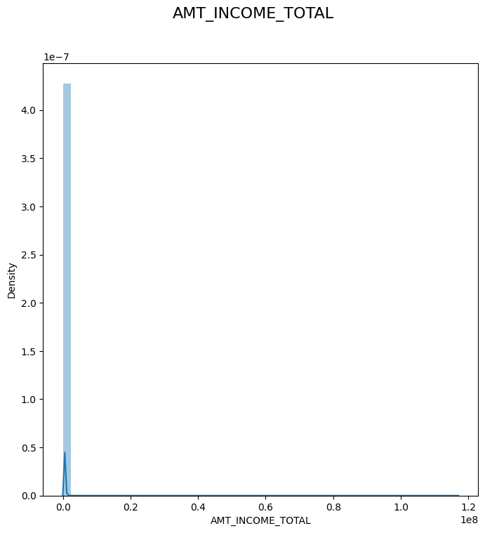
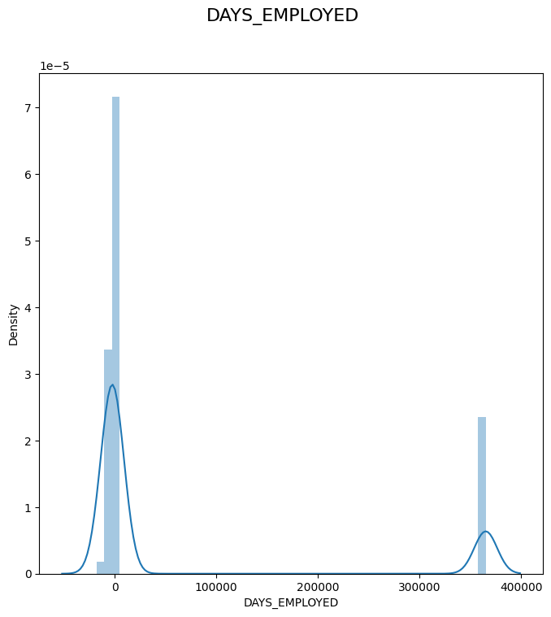
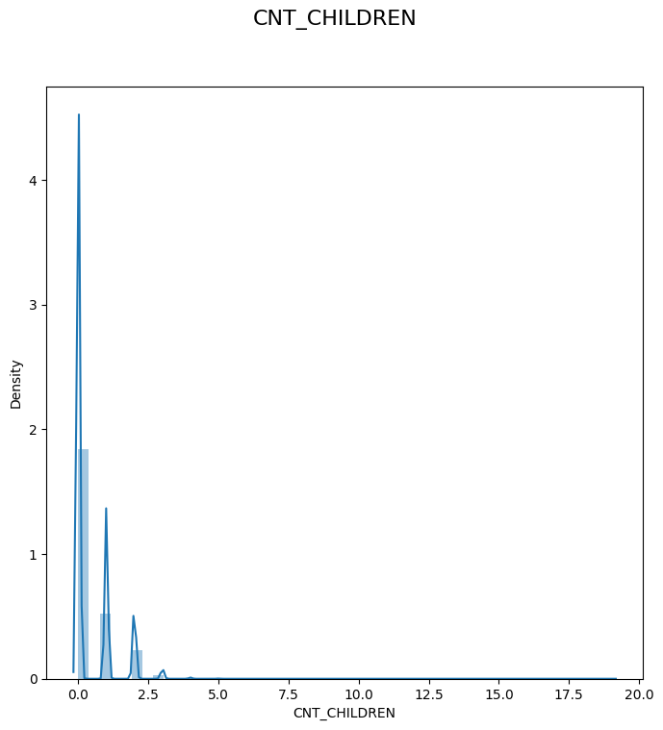
Identifying Outliers
Here are some of the values that have been identified as outliers through the use of plots:

Slide 9
Outlier Observation
In the plot `DAYS_EMPLOYED` there is a value present at 36k range, which is impossible.
In the plot `CNT_CHILDREN`, we can see a point at high value of outlier, i.e., 19. It's very rare for a family to have `19 children`.
In the plot `AMT_INCOME_TOTAL`, we can see that the highest value is way larger than other points.

Slide 10
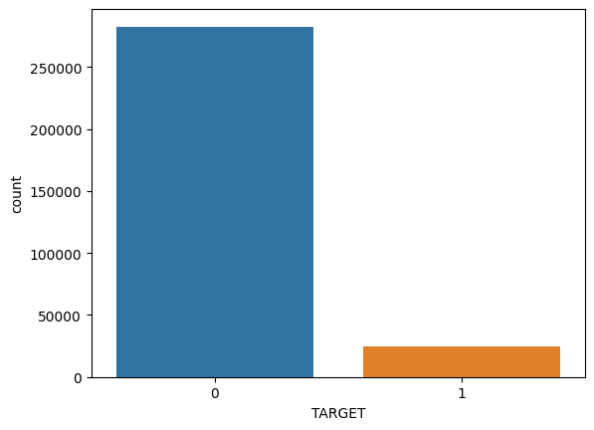
Analyzing Application Data
There is a noticeable imbalance in our target variable
Therefore, we can split the Target variable into two separate dataframes.

Slide 11
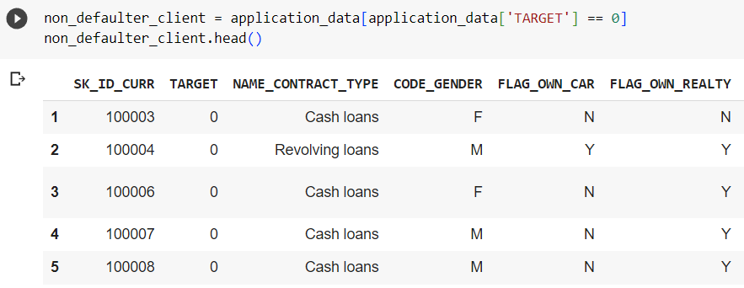
Good Client
By splitting the application_data based on the Target variable, we can create two separate dataframes.
A value of 0 indicates that the client is not a defaulter and is considered a good client.

Slide 12
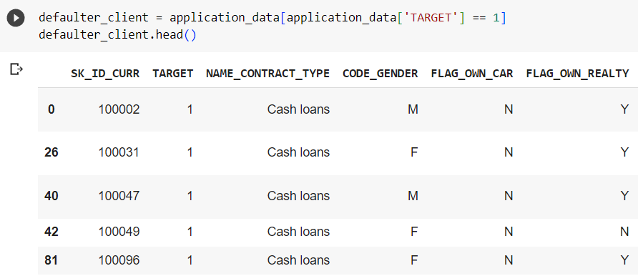
Defaulter Client
On the other hand, a value of 1 indicates that the client has payment difficulties, with late payments exceeding a certain threshold on one or more of the initial loan installments.

Slide 13
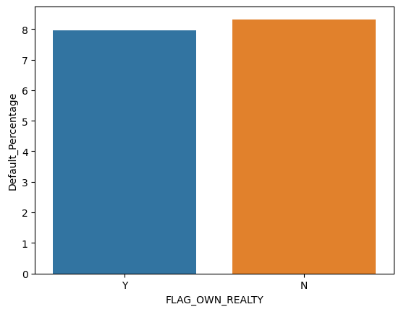
Property Ownership v/s Default Percentage
Creating a plot to illustrate the number of property owners and non-property owners based on the target variable, specifically when the target variable is equal to 1.
Based on the graph, it is evident that the number of loan defaulters, represented by non-payers of the loan, is approximately 9% and is closely comparable to the other category.

Slide 14
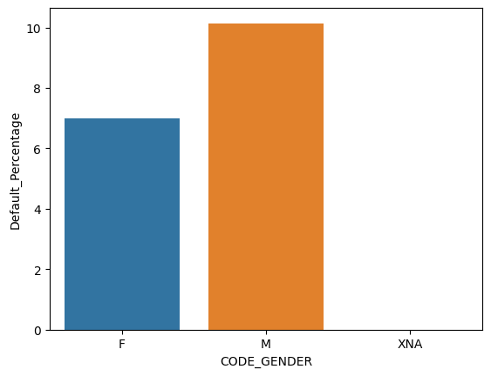
GENDER v/s Default Percentage
Creating a plot to illustrate the number of male and female clients based on the target variable, specifically when the target variable is equal to 1.
Based on the plots, it is evident that female clients are more likely to be a better target compared to male clients.
The percentage of defaulted credits is higher for male clients (10.14%) compared to female clients (7%).
This indicates that male clients have a higher likelihood of not repaying their loans.

Slide 15
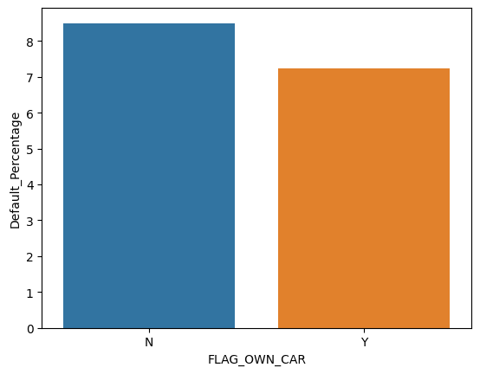
Car Owners v/s Default Percentage
Creating a plot to illustrate the distribution of car owners and non-car owners based on the target variable, specifically when the target variable is equal to 1.
Based on the graph, it is apparent that clients who own a car are less likely to default on their loans compared to those who do not own a car.

Slide 16
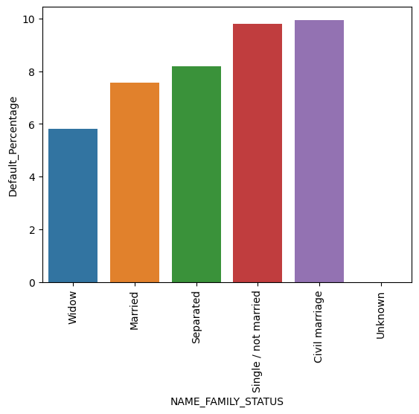
Family Status v/s Default Percentage
Creating a plot to illustrate the relationship between the family status of clients and the target variable, specifically when the target variable is equal to 1.
Based on the graph, we can observe that the percentage of loan non-repayment is highest for clients with a civil marriage status and lowest for widows.
This finding is intriguing because typically one might expect widows to have difficulty in loan repayment, but the data suggests the opposite trend.

Slide 17
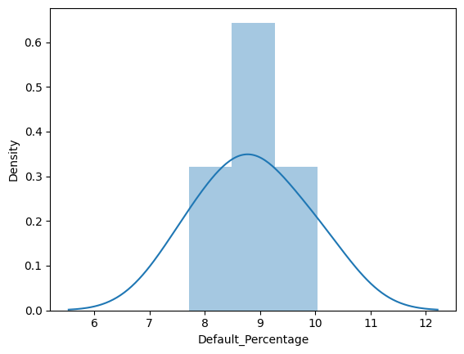
Number of Children per Client v/s Default Percentage
Creating a plot to illustrate the relationship between the number of children per client and the target variable, specifically when the target variable is equal to 1.
Clients with a higher number of children are more likely to face difficulties in repaying their loans.
This could be attributed to the increased financial responsibilities and liabilities associated with having more children.
The greater number of dependents makes it more challenging for the client to allocate funds for loan repayment, as they have additional personal expenditures to manage.

Slide 18
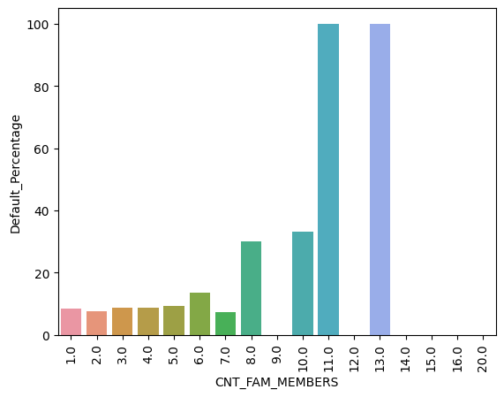
Number of Family Members per Client v/s Default Percentage
Creating a plot to illustrate the number of family members per client based on the target variable, specifically when the target variable is equal to 1.
While it is evident that families with 11 and 13 members have the highest default rate, it is important to note that the number of such families is quite low, with only two in the dataset.

Slide 19
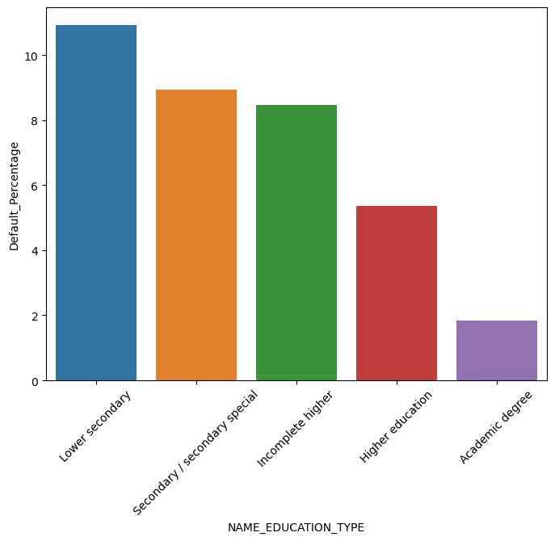
Education Type v/s Default Percentage
Create a plot illustrating the relationship between the education type of each client and the target variable, specifically when the target variable is equal to 1.
The graph indicates that clients with higher education levels are more likely to repay their loans.
This observation can be attributed to the likelihood of such clients having more stable jobs and a consistent monthly income.

Slide 20
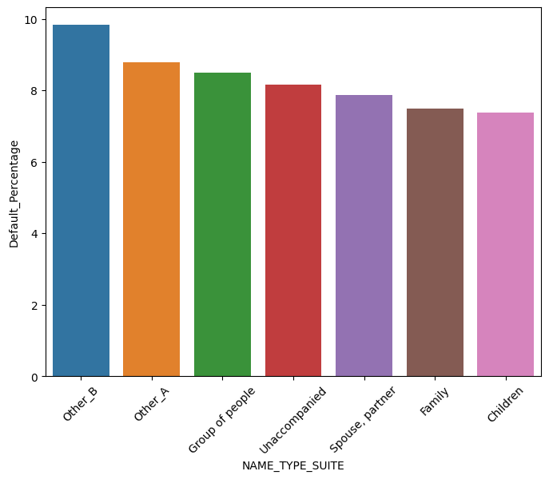
Accompanying Client v/s Default Percentage
Create a plot illustrating the relationship between the Accompanying Client and the target variable, specifically when the target variable is equal to 1.
Most clients who were occupied by Other_B followed by Other_A are unlikely to pay back their loans.

Slide 21
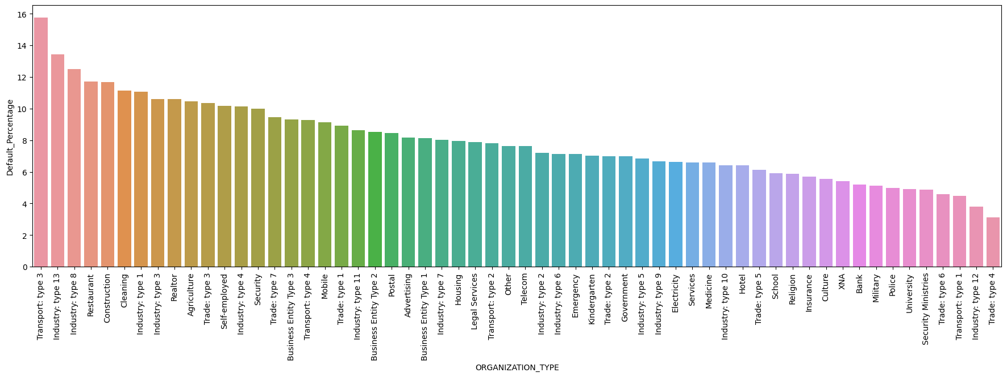
Organization Type v/s Default Percentage
Based on the above graph, the highest number of loan non-repayments can be observed among applicants working in Transport Type3.

Slide 22
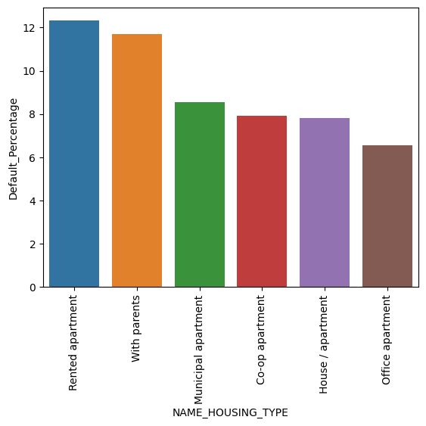
Housing Type v/s Default Percentage
Create a plot illustrating the relationship between the housing type of each client and the target variable, specifically when the target variable is equal to 1.
Based on the above graph, it is evident that individuals with rented apartments are less likely to repay their loans.
This could be attributed to the fact that they already have additional liabilities, which may impact their ability to fulfill loan repayment obligations compared to individuals who do not have this specific liability.

Slide 23
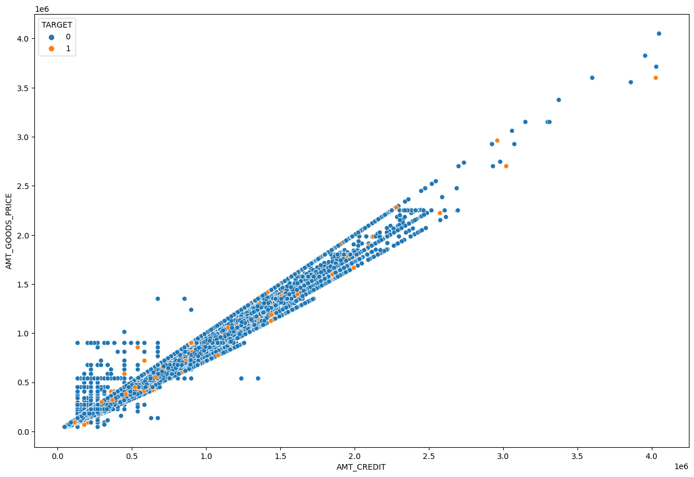
BIVARIATE ANALYSIS

Slide 24
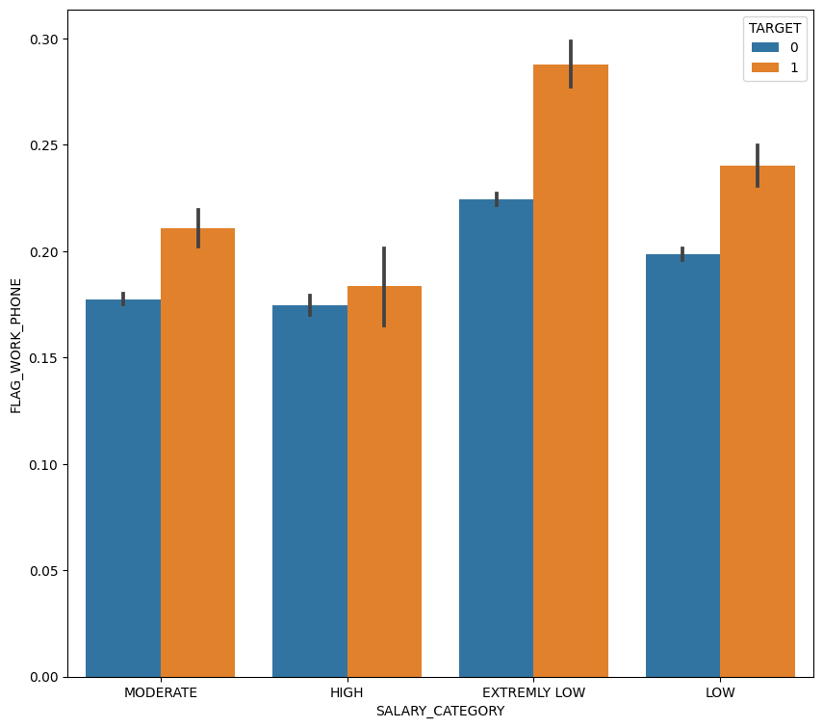
Salary Category vs Client who provided Home Number
Clients with an extremely low salary are more likely to be defaulters, particularly when they did not provide a home phone number.
It is worth noting that only approximately 30% of people provided their phone numbers.

Slide 25
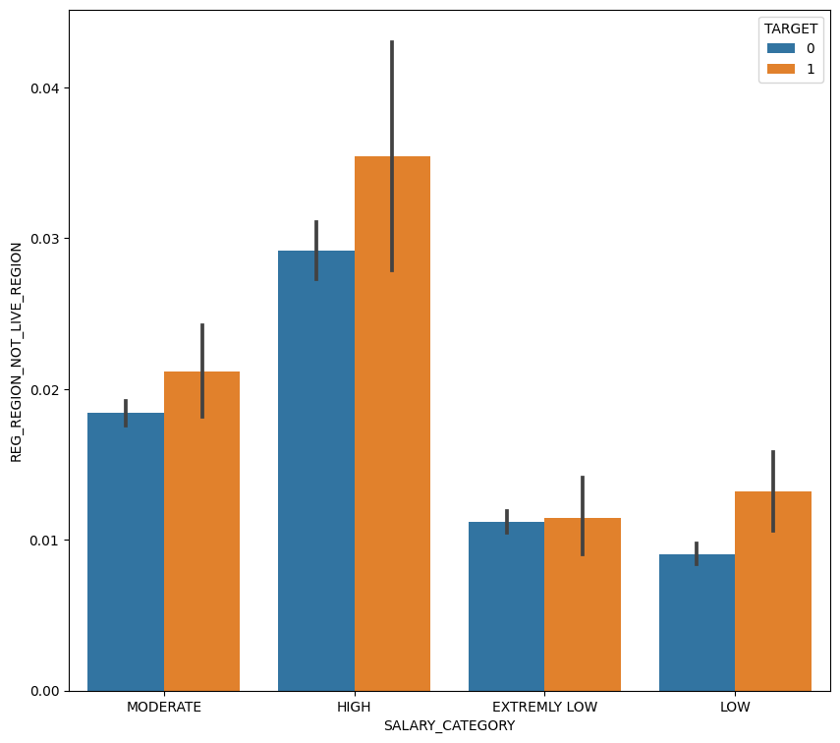
SALARY V/S CLIENT WHOSE PERMANENT ADDRESS NOT MATCH WITH
CONTACT ADDRESS - REGION LEVEL
Comparing the salary of clients whose permanent address does not match their contact address at the region level.
When a client receives an extremely low salary and their address does not match, there is a higher likelihood for them to be a defaulter.

Slide 26
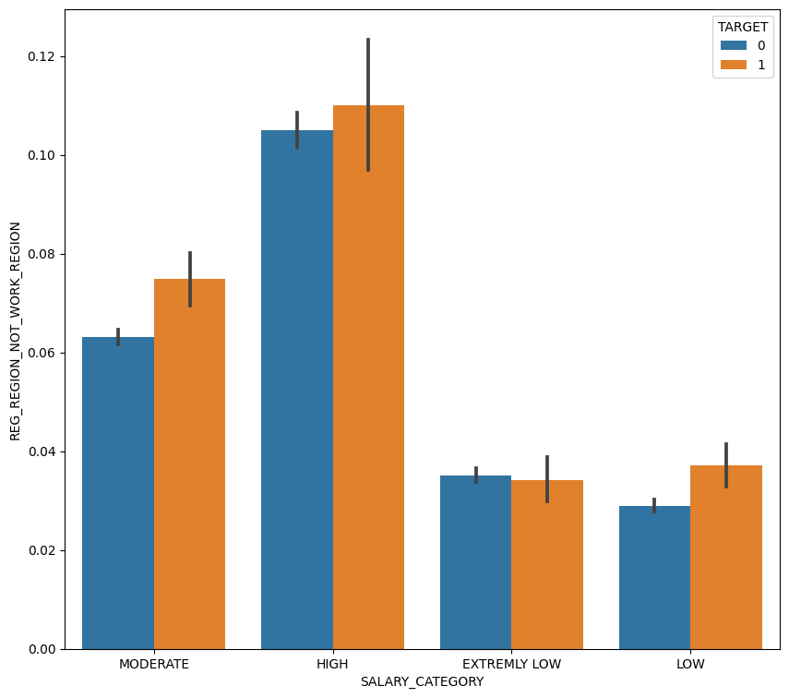
SALARY V/S CLIENT WHOSE PERMANENT ADDRESS NOT MATCH WITH
WORK ADDRESS - REGION LEVEL
Analyzing the relationship between salary and clients whose permanent address does not match their work address at the region level.
When a client receives an extremely low salary and their work address does not match, there is a higher likelihood for them to be a defaulter.

Slide 27
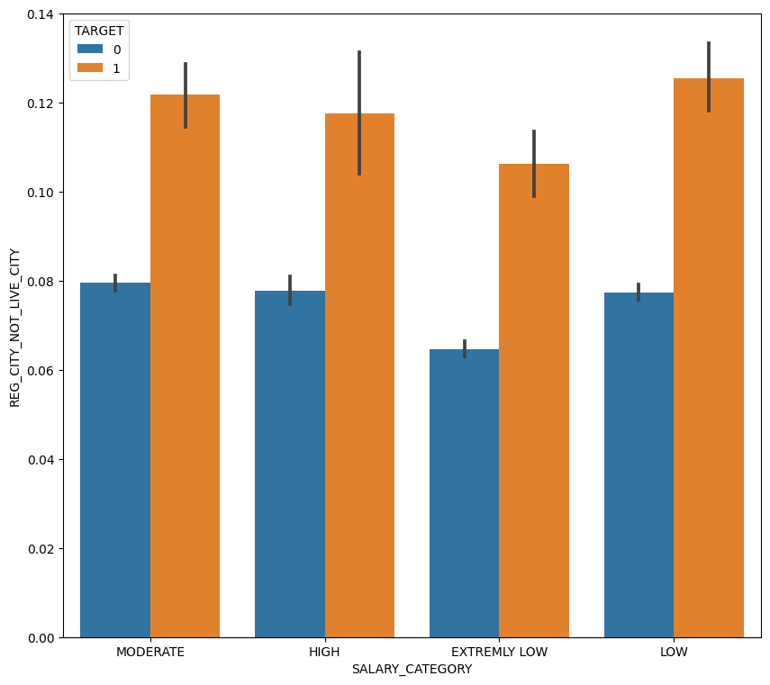
Salary v/s Clients Whose Permanent Address does
not match their Contact Address at the City Level
Examining the correlation between salary and clients whose permanent address does not match their contact address at the city level.
When a client receives a lower salary and their CONTACT address (CITY LEVEL) does not match, there is a higher probability of them being a defaulter.

Slide 28

Salary v/s Clients Whose Permanent Address does
not match their Work Address at the City Level
Analyzing the relationship between salary and clients whose permanent address does not match their work address at the city level.
When a client receives a lower salary and their work address (city level) does not match, there is a higher probability of them being a defaulter.

Slide 29
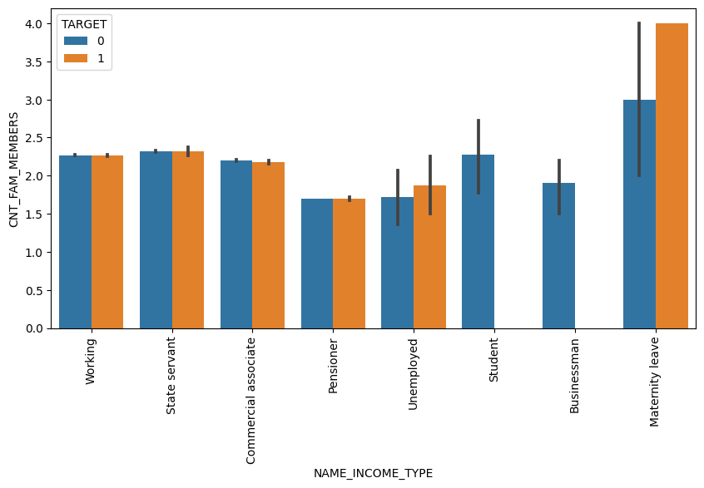
Income Type v/s Number of Family Members
Analyzing the relationship between income and the number of family members.
Individuals who receive income through maternity leave tend to have a higher likelihood of being defaulters when they have a greater number of family members.

Slide 30
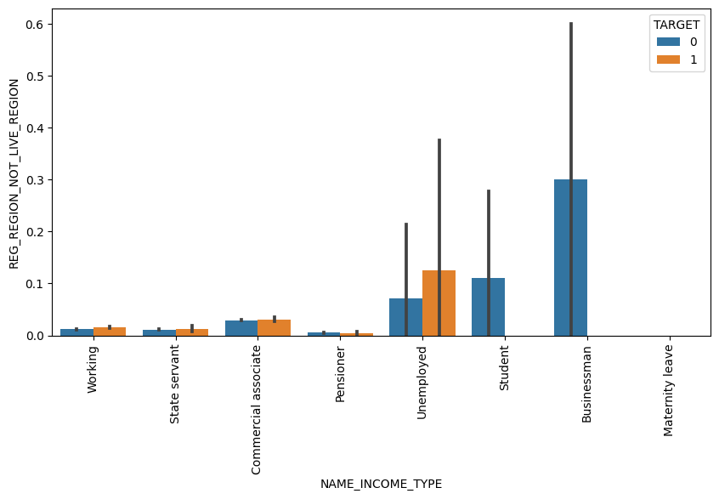
Income Type v/s Clients Whose Permanent Address does
not match their Contact Address at the Region Level
Based on the bivariate analyses, certain columns have been identified as being irrelevant or providing no useful information.
Therefore, we have decided to drop those columns from the dataset.

Slide 31
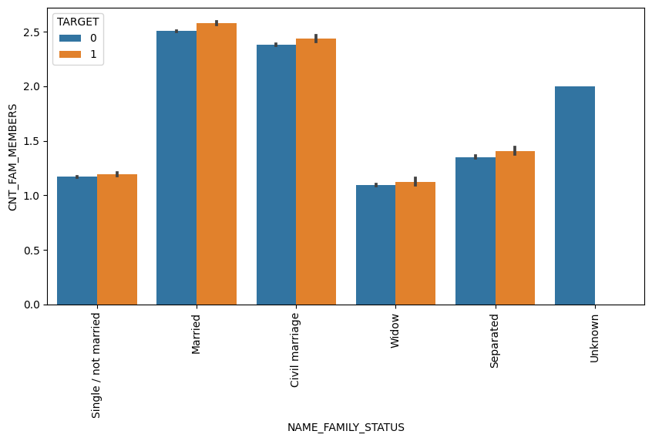
Family Status v/s Count of Family Members
Clients who are married and have a higher count of family members, particularly with more than five children, have a higher probability of being defaulters.
This trend could be attributed to the economic situation of their family, as having more children often leads to increased financial responsibilities and potential difficulties in meeting loan repayment obligations.

Slide 32
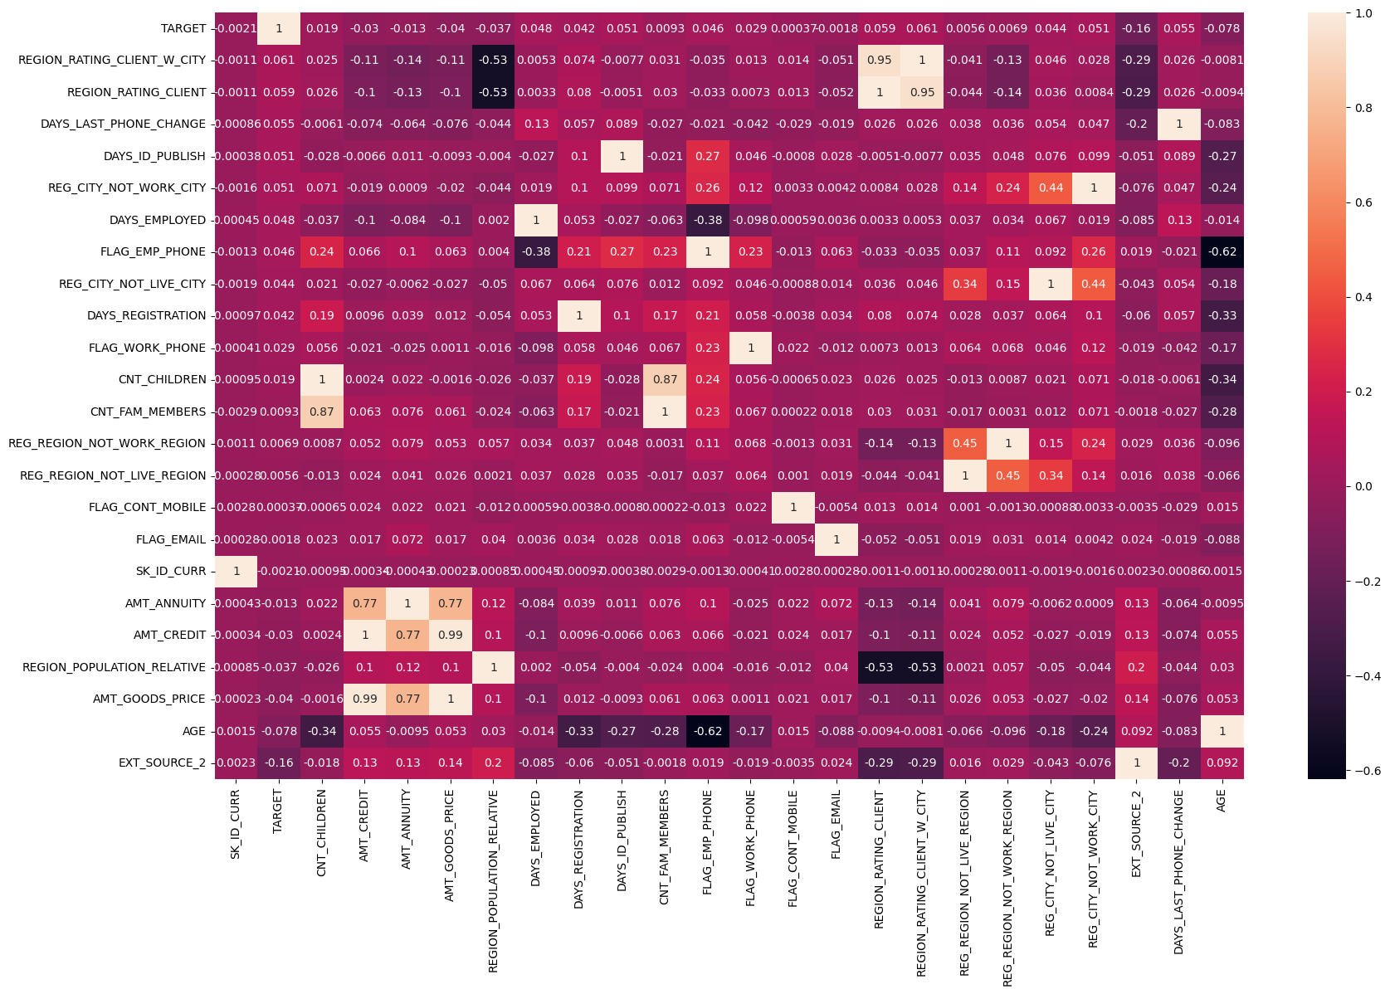
Correlation between the Target Variable v/s Other Variables
Identifying Highly Correlated Variables:
AMT_CREDIT and AMT_GOODS_PRICE =0.99
REGION_RATING_CLIENT_W_CITY and REGION_RATING_CLIENT = 0.95
CNT_FAM_MEMBERS and CNT_CHILDREN = 0.87
AMT_ANNUITY and AMT_CREDIT = 0.77

Slide 33
Previous Loan Applications
Analyzing the Second Dataset
After completing the necessary data cleaning steps, we proceeded to analyze the second dataset.
This involved performing further data cleaning and preprocessing as needed.
Once the data was prepared, we began exploring and analyzing the information it contained to gain insights and make meaningful observations.

Slide 34
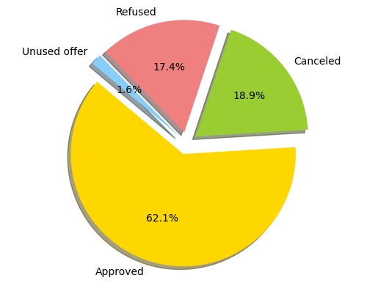
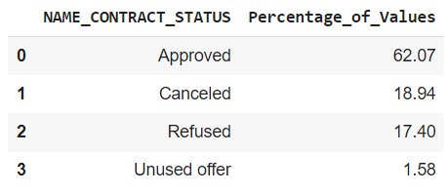
Percentage of Contract Status

Slide 35
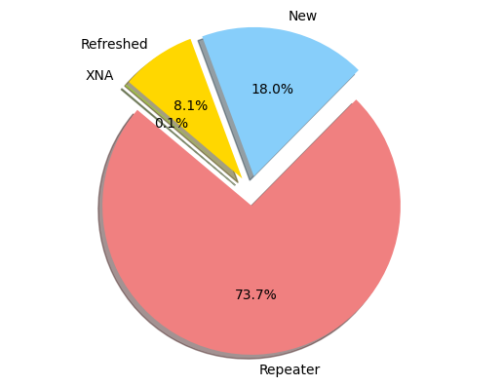
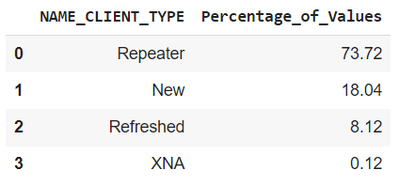
Percentage Distribution of Client Type
Based on the analysis, 73.72% of the applicants are repeat clients, while only 18.4% are new clients.

Slide 36
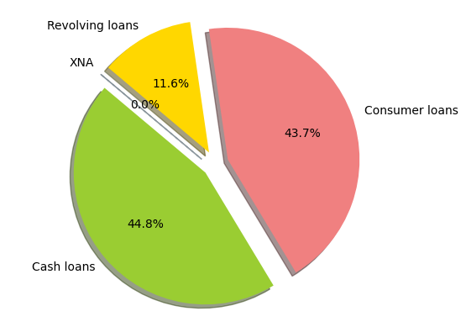
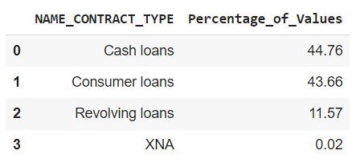
Percentage Distribution of Contract Type

Slide 37
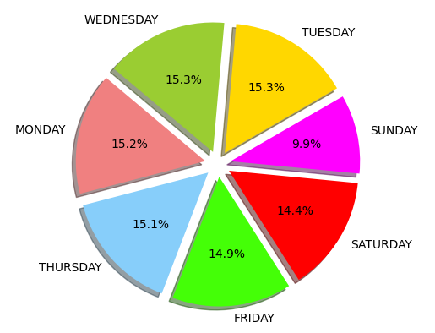
Days of approval
The majority of clients choose to apply for loans on Tuesdays, which is intriguing considering the relatively low number of applicants on weekends.
It is unexpected, as one would assume that applicants would prefer weekends for the loan application process.

Slide 38
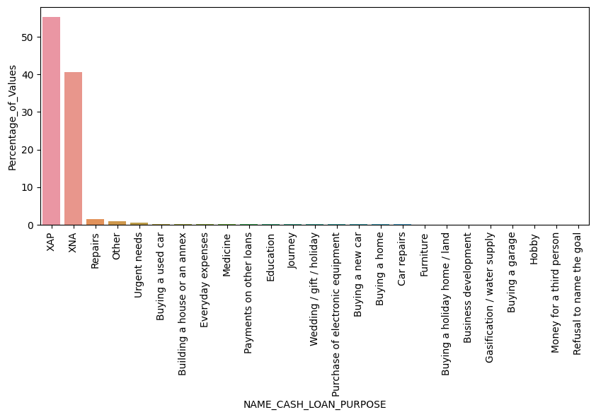
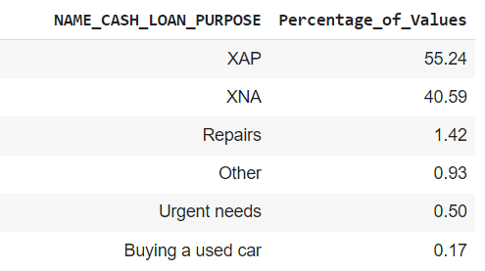
Purpose of loan
The majority of loan purposes were not recorded, with the highest values being assigned to `XAP` and `XNA`.

Slide 39
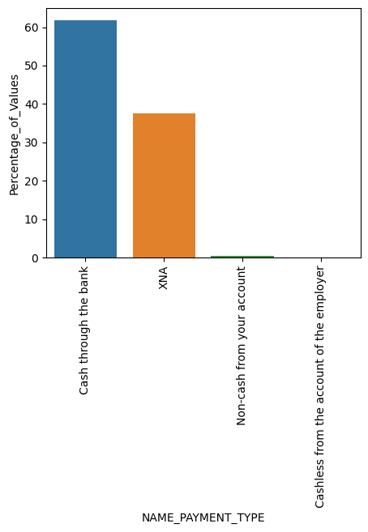
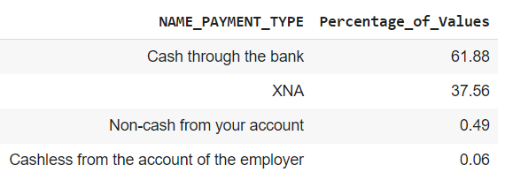
Payment Type
The majority of individuals (61.88%) opted for cash as their preferred payment method.

Slide 40
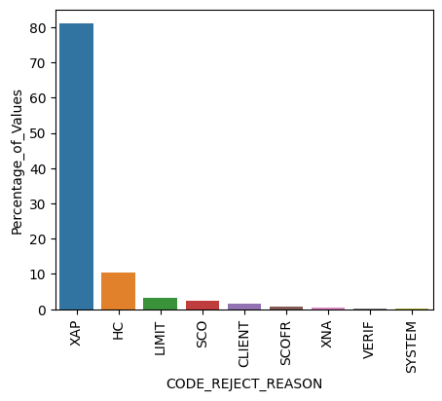
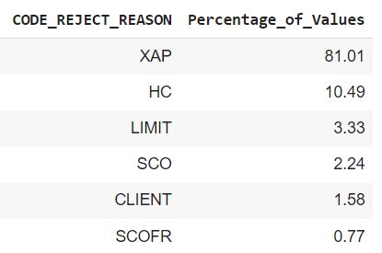
Reasons for Loan Rejection
The primary reason for loan rejections is (XAP (81%)) followed by HC.

Slide 41
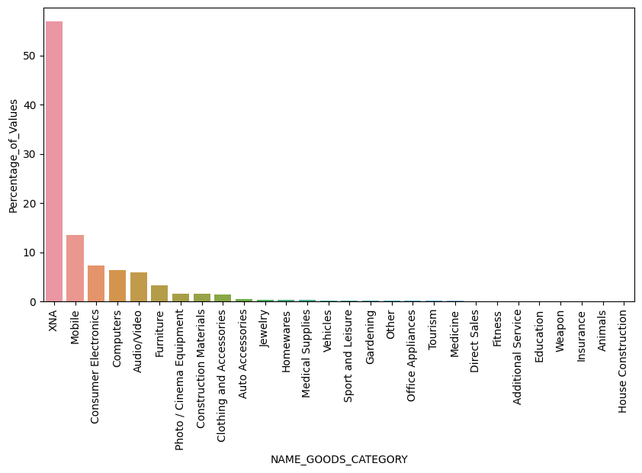
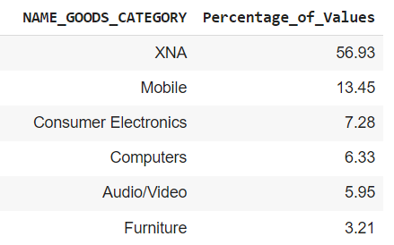
Types of Goods
The majority of clients applied for mobile goods, while 53.96% of the data is not recorded (represented as XNA).

Slide 42
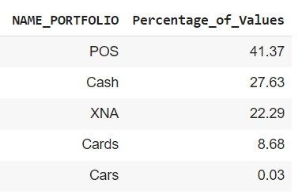
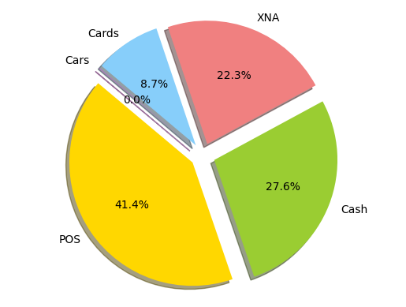
Percentage Distribution of Portfolio
POS accounted for 41.4% of the applications.

Slide 43
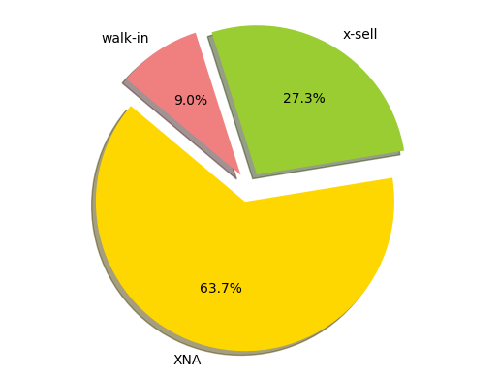
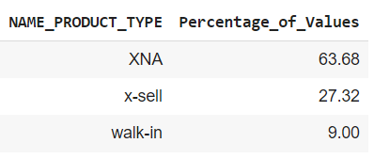
Percentage Distribution of Product Types
X-sell applications accounted for a higher percentage compared to walk-in applications.

Slide 44
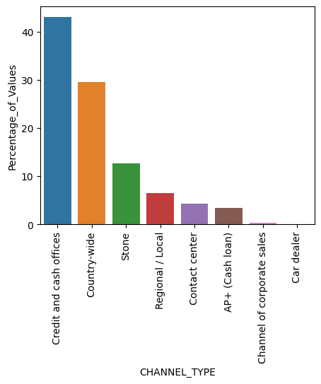
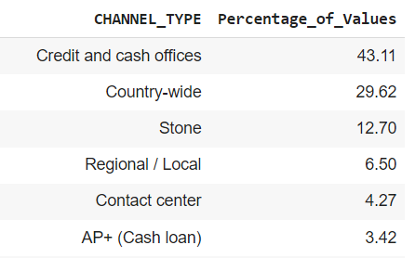
Percentage Distribution of Channels
The majority of clients were acquired through Credit and Cash Offices.

Slide 45
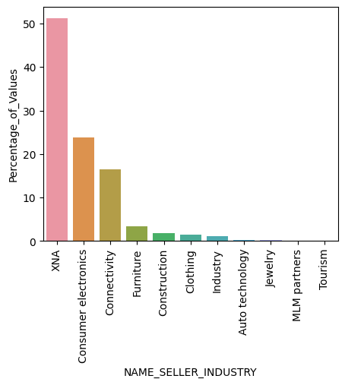

Industry of the Seller
The majority of sellers belong to the Consumer Electronics industry.

Slide 46


Percentage of Yield Group
The majority of the interest rates fall within the medium range.

Slide 47

Percentage of Different Product Combinations
The most common product combination is Cash, followed by POS household with interest.

Slide 48


Percentage of Clients Who Requested Insurance
The majority of clients made their last application of the day.

Slide 49

Correlation in previous_data
The above plot illustrates the correlation between variables in the previous application.

Slide 50

Correlation between previous_data and application_data
Similarly, in this case as well, we can observe that the same variables that we identified in the application data are also playing a significant role in identifying the defaulters.

